Slide 2
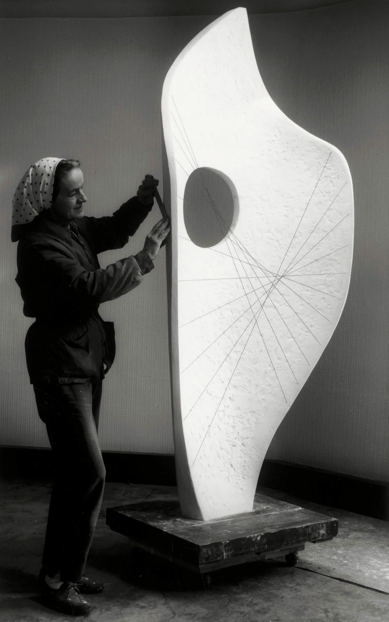
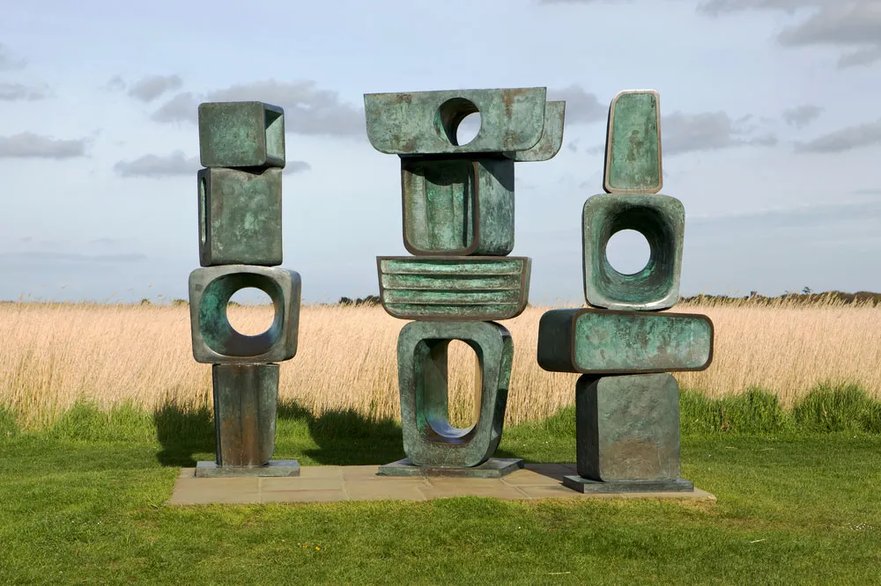
Hepworth Class
Jess Jackson-Virk
TLA’s: Manjit, Selime and Jerene
jjacksonvirk@millfields.hackney.sch.uk
Class Teacher

Slide 3
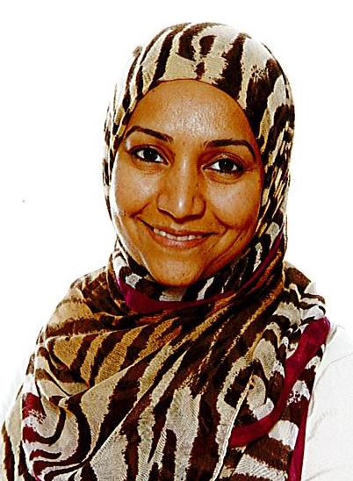
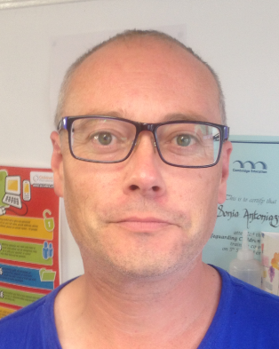
amohi@millfields.hackney.sch.uk
Phase Lead for Key Stage 1
kfry@millfields.hackney.sch.uk
SENCO - Special educational needs coordinator

Slide 4
We will discuss:
Year 2 in 2022-2023
Curriculum
Homework
Communication
Questions

Slide 5
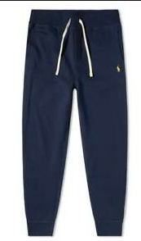
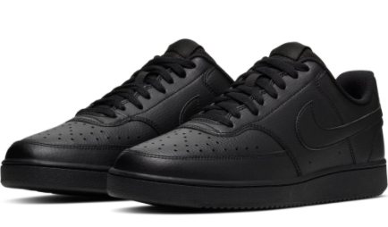
PE days and kit
Hepworth have PE on the following days:
Wednesday and Thursday
Please ensure that your child comes to school wearing their PE kit on these days.
Most lessons will be outside

Slide 6
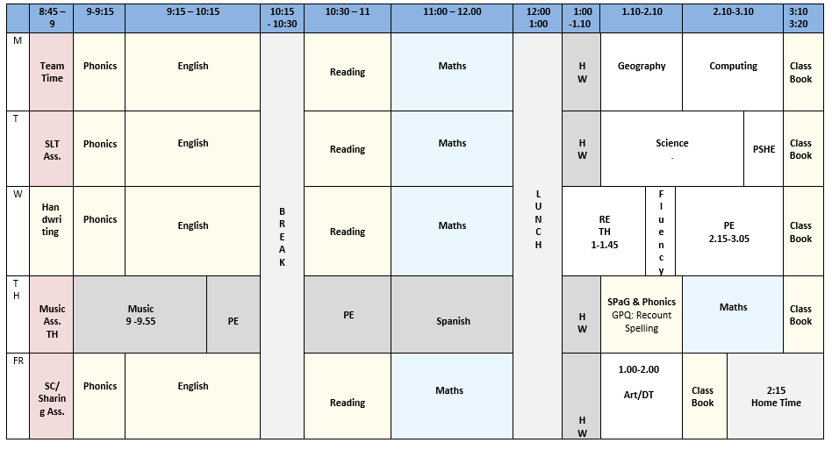
Year 2 Example Timetable

Slide 7
Year 2 Curriculum

Slide 8
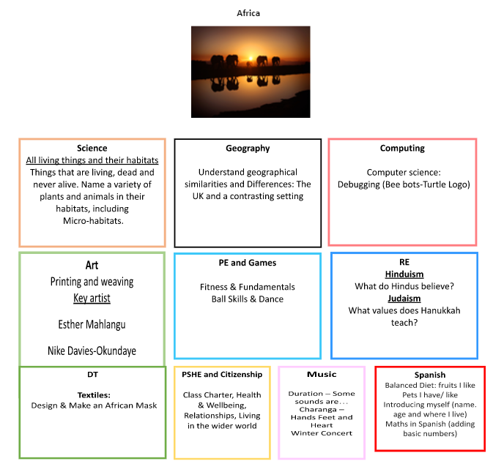
Autumn Term

Slide 9
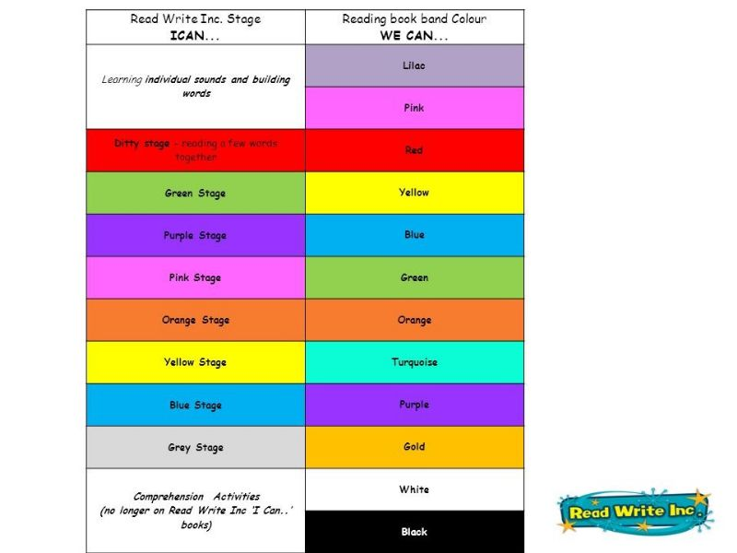
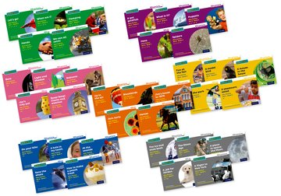
Autumn Term
English
Reading, Writing & SPAG

Slide 10
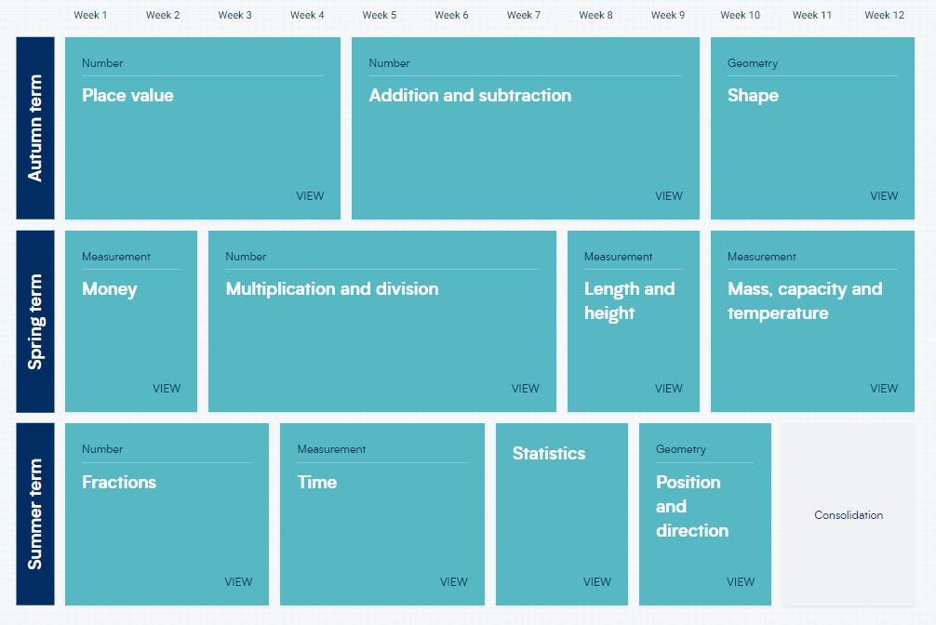
Autumn Term
Maths –Overview of the Year

Slide 11
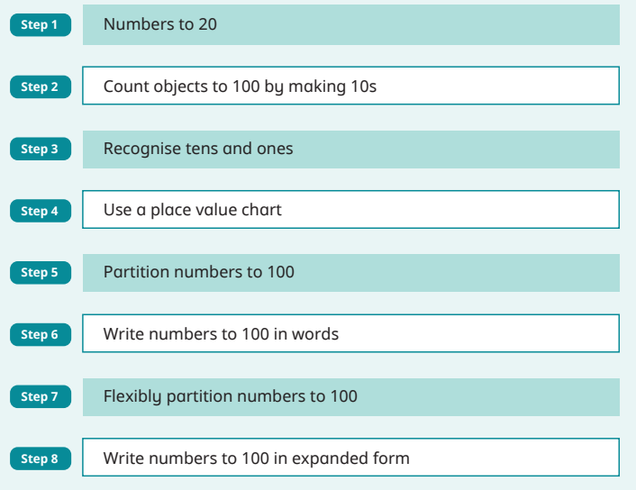
Autumn Term
Maths

Slide 12
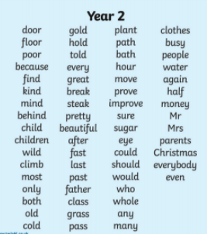
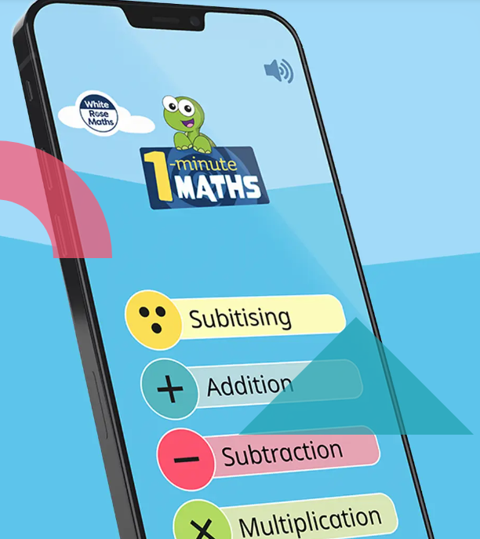
Year 2 Homework
Reading
Spelling
Maths
1 minute maths app

Slide 13
Year 3 Homework Expectations
Year 2 Homework
Homework projects sent at the beginning of each term to be completed by the end of each term.

Slide 14
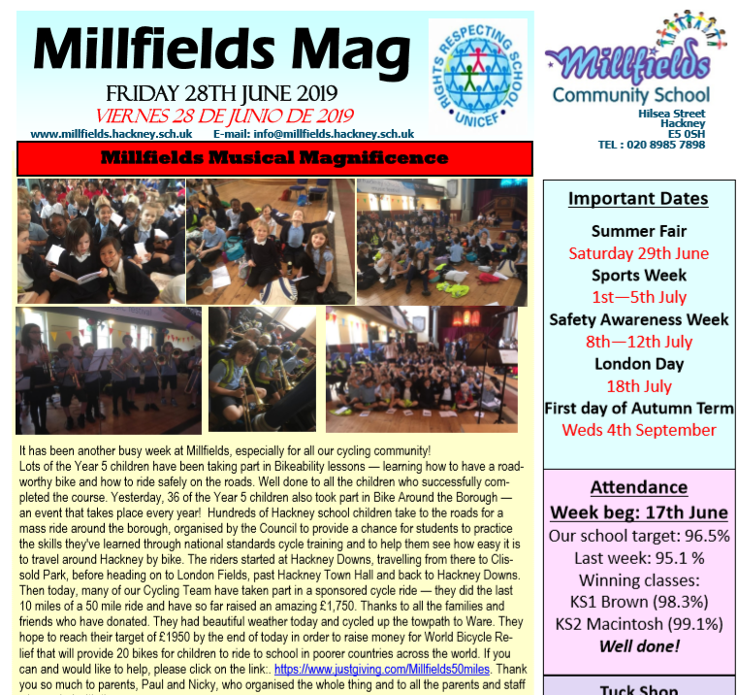
Communication
http://www.millfields.hackney.sch.uk/

Slide 15
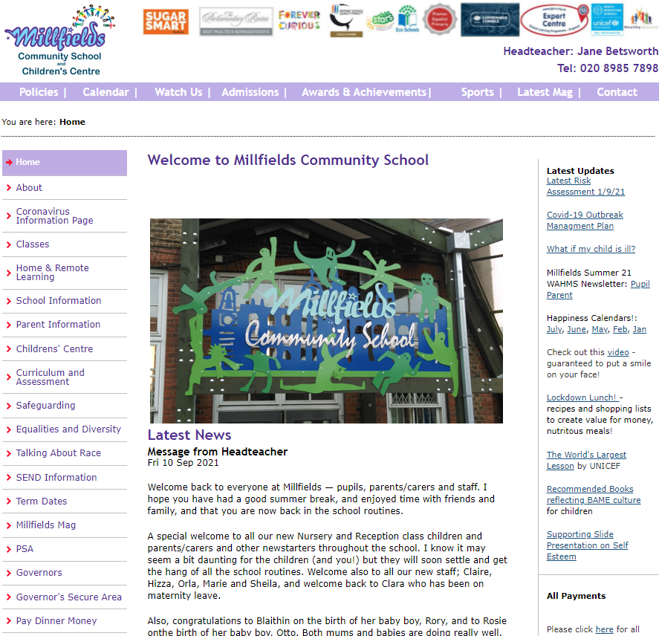
Millfields Website
http://www.millfields.hackney.sch.uk/

Slide 16
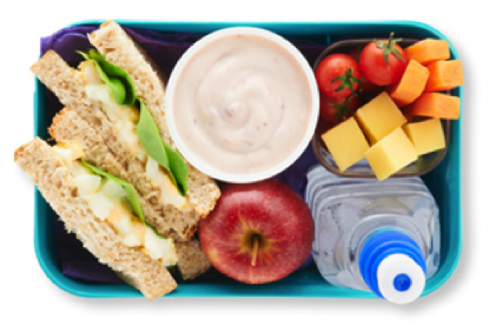
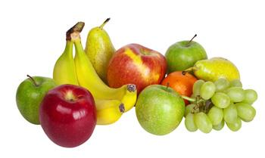
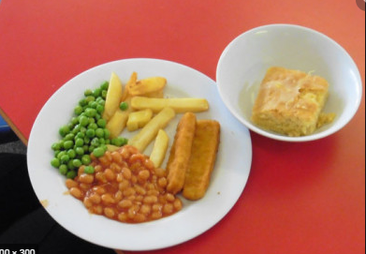
Lunches
Clubs
Please book and pay for school lunch or clubs

Slide 17
Important Dates
What? | When?
Hepworth Nativity | 6th December
End of Autumn term 1 | 2:15pm on Friday 21 October.
End of Autumn term 2 | 2:15pm on Friday 16th December.

Slide 18
Questions

